Slide 1
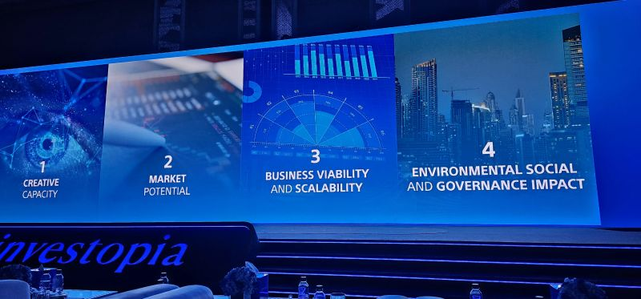

Investopia Media Analysis Report February – March 2024

Slide 2
01 Scope of Work
Objectives
Parameters
The objective of this report is to provide a comprehensive assessment of Investopia’s media coverage across traditional and social media platforms. The analysis combines quantitative metrics with qualitative insights to evaluate visibility, tonality, thematic drivers, and strategic positioning.
Timeframe
The report covers February – March 2024.
Markets
Global (dominant UAE)
Media Types
Newspapers, Websites, X, LinkedIn, Instagram.
Languages
English and Arabic
Matrices
Articles Impressions Country Breakdown Trends Over Time Platform Breakdown Tonality Analysis Themes Analysis Top Outlets
Research Methodology
The report is based on a curated sample of 1,189 traditional media articles and 519 unique social media posts collected across multiple platforms and markets. The coverage was analyzed against a predefined set of metrics, combining quantitative measurement (volume, impressions, country distribution, and engagement) with qualitative assessment (tonality, thematic drivers, and narrative trends).

Slide 3
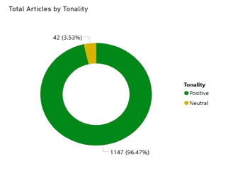
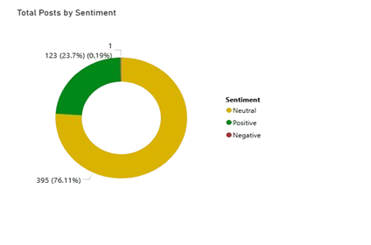
Traditional & Social Media Coverage/Tonality
Impressions
Articles
35M
1189
Reach & Engagement
Investopia achieved strong media visibility across both traditional and digital channels, generating 1,189 media articles and 519 social posts during the reporting period.
Traditional media coverage was overwhelmingly positive (96%), indicating strong institutional alignment and favorable positioning.
Social media conversation was predominantly neutral and informational, reflecting event-driven participation rather than opinion-led debate.
No significant negative sentiment was recorded, highlighting stable reputational performance.
20K
519
ENGAGEMENT
14M
POSTS
INPRESSIONS

Slide 4
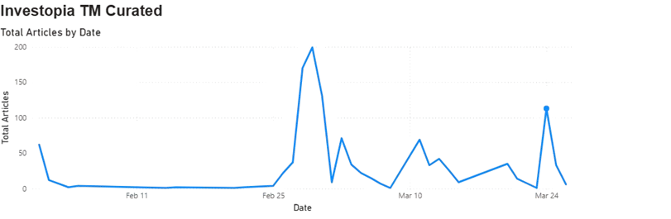
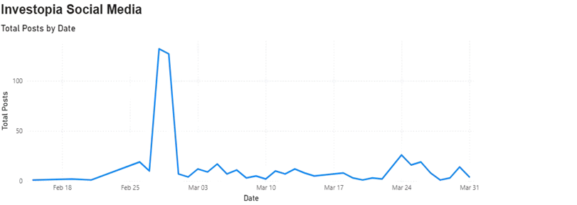
Coverage Trend Over Time
29 February (~200 articles)
Media coverage was highly event-driven, with the most significant surge occurring on 29 February (~200 articles), driven by strategic announcements related to innovation and sustainable growth.
A second notable spike on 24 March (113 articles) was associated with investment fund and trade-tech developments.
24 March (113 articles)
28 February (132 posts)
Social media activity peaked one day earlier 28 February (132 posts), indicating early digital amplification preceding broader media pickup.

Slide 5
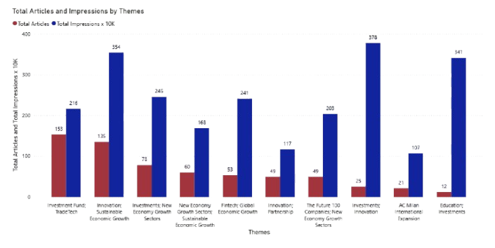
Traditional Media Themes Analysis
Themes | Articles | Impressions
Investment Fund / Tradetech | 153 | 2.16M
Innovation Sustainable Economic Growth | 135 | 3.54M
Investment in New Economic Growth Sectors | 78 | 2.45M
Investment Innovations | 25 | 3.78M
Educations Investments | 12 | 3.41M
Traditional coverage centered on structured investment mechanisms, innovation, and sustainable economic transformation.
Innovation-driven investment narratives generated the highest impressions, reinforcing Investopia’s positioning as a long-term economic catalyst.
Education-linked and growth-sector themes expanded the scope of coverage beyond finance into broader development discourse.

Slide 6
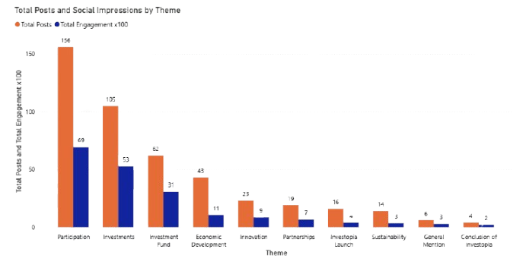
Social Media Themes Analysis
Themes | Posts | Engagement
Participation | 156 | 6.9K
Investments | 105 | 5.3K
Investment Fund | 62 | 3.1K
Economic Development | 45 | 1.1K
Innovation | 25 | 0.9K
Social media engagement was primarily driven by participation-related content, reflecting strong real-time interaction around event attendance and involvement.
Investment-focused themes also generated significant engagement, demonstrating audience interest in tangible financial initiatives.
Compared to traditional media’s strategic framing, social platforms emphasized execution, participation, and immediate outcomes.

Slide 7
Traditional Media Vehicle & Market Breakdown
Outlet | Articles
Nabd (EG) | 43
UAE News App (AR) | 28
Zaya (EN) | 22
Press News | 21
Khaleej Voice | 19
Outlet | Impressions
Al Khaleej | 3.21M
Al Etihad | 2.94M
CNN | 2.83M
Nabd (EG) | 2.33M
TradingView (US) | 2.28M
Country | Article
UAE | 589
Egypt | 124
Saudi Arabia | 107
United States | 88
Italy | 38
In terms of article volume, digital and aggregator platforms such as Nabd (Egypt), UAE News App, and Zawya contributed significantly to distribution, indicating strong digital pickup.
Influence weight was concentrated within key institutional outlets, particularly Al Khaleej (3.2M impressions), followed closely by Al Etihad (2.9M impressions), and CNN (2.8M impressions), demonstrating that audience reach was driven by established national and international media rather than digital aggregators.
Media coverage was primarily concentrated in the UAE (589 articles), reflecting strong domestic positioning, with regional amplification across Egypt (124 articles) and Saudi Arabia (107 articles)

Slide 8



Social Media Platform & Influencer Breakdown
Media Platform Breakdown
284
11.3K
POSTS
POSTS
LinkedIn emerged as the dominant platform in both volume and engagement, highlighting Investopia’s strong resonance within professional and investment-focused audiences.
Engagement was driven not only by official activity but also by ecosystem and institutional accounts, including IOTA, Mubadala, and Yarakhdairofficial, reflecting strong stakeholder amplification.
The prominence of institutional handles suggests that Investopia’s messaging is embedded within a broader economic and innovation network, reinforcing credibility and influence.
Compared to other platforms, LinkedIn functioned as the primary channel for structured investment dialogue rather than informal social interaction.
155
4.3K
POSTS
POSTS
80
4.2K
POSTS
POSTS
Handle | Engagement
Iota | 968
Mubadala | 949
Yarakhdairofficial | 879
Nathaliemamo | 878
WAMNEWS_ENG | 776

Slide 9
Key Strategic Insights
Recommendations
Investopia achieved strong reputational performance, with overwhelmingly positive traditional coverage and minimal negative sentiment across channels.
Media narratives centered on innovation, sustainable economic growth, and structured investment mechanisms, reinforcing long-term positioning.
LinkedIn emerged as the primary social platform, with engagement driven by institutional and ecosystem stakeholders.
Coverage demonstrated strong domestic (UAE) concentration with regional amplification across the GCC.
Expand international media outreach beyond the GCC to increase global economic positioning and diversify geographic exposure.
Strengthen relationships with high-reach institutional outlets to maximize impression impact rather than focusing solely on article volume.
Continue leveraging LinkedIn as the primary professional engagement channel, with increased thought-leadership content from key stakeholders.
Increase interactive social content around major announcements to convert participation-driven engagement into sustained dialogue.
Develop post-event narrative follow-ups to maintain media momentum beyond peak announcement periods.

Slide 10
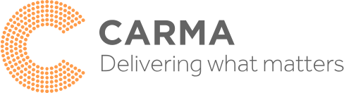
About CARMA
We deploy the best technology worldwide, but we are not a software licensing company, we are a people-first, client-centric provider of quality media intelligence services, that help you measure your reputation and communications worldwide.
CARMA is a global provider of media intelligence solutions. Our media monitoring, analysis, and database solutions are designed to deliver real insights and power-informed decision-making. With over 30 years of knowledge and experience and a presence in over 41 countries, we have the capacity to deliver the most comprehensive global monitoring program across any media platform in any language.
Confidentiality
All the information, data, and designs contained in this report are the intellectual property of CARMA and are strictly to be used exclusively by Investopia. The contents of this report may not be copied, reproduced, distributed or displayed to third parties without CARMA’s express written consent.
CARMA advocates the use of a Valid Metrics Framework, as advised by our industry body AMEC, to measure the success of your communications efforts, as opposed to AVE, which is a controversial metric to use in the communications evaluation sector. It is not in line with best practices and has been globally derided as flawed. CARMA encourages our clients to move away from its use but acknowledges that doing so may not be easy. Please contact your Relationship Manager who will be pleased to advise and help you update your measurement program.
Our global team of researchers and analysts sifts through the noise to make sense of the data and deliver what matters.
CARMA’s globally renowned methodology uses a balance of automation and curation to capture global media coverage and deliver deep insights, with sector expertise, communications performance scoring, competitor intelligence, message resonance, and C-level reporting.
We can offer you monitoring and analysis in print, online, broadcast, and social media in any country in any language – contact your Relationship Manager for more information. If you have any comments/requests or feedback regarding this report, please feel free to contact your Relationship Manager directly or Shirin.pervez@carma.com.

